Slide 1
Data Analysis for i Phone 15

Slide 2

Our Team
Harsh Shailesh Dhankara (Data Science)
Kislay Kislay (Data Science)
Mohammed Salman Taqi (Data Science)
Vatsal Jigar Kadakia (Data Science)

Slide 3
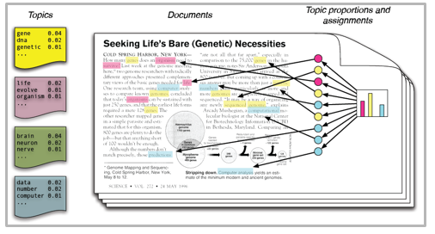


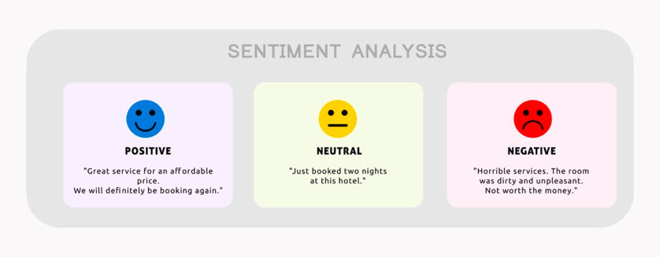
ABOUT THE PROJECT
Topic
Modelling
Build Semantic Network
Scrape tweets from Twitter API
Perform Sentiment Analysis
Data Cleaning
Notes:
In today's world, social media platforms have become an essential part of people's lives, and the amount of data generated from these platforms is enormous.
Product sentiment analysis is a crucial field of study that aims to extract and analyze people's opinions and sentiments towards a particular product or brand from social media data
The purpose of this project is to perform a product sentiment analysis of Apple's new product, iPhone 15, using Twitter data.
In this project, we will scrape tweets from Twitter API and perform sentiment analysis to determine the overall sentiment towards the iPhone 15. We will also build a semantic network to identify the most concerning and positive words associated with the product. Also we will perform Topic Modelling to find different topics associated with iphone 15.
Product sentiment analysis has gained significant attention in recent years due to its numerous applications, such as product improvement, brand management, and marketing strategies. By analyzing the sentiment of customers towards a product or brand, companies can make informed decisions and improve their products and services to meet customer needs and preferences.

Slide 4

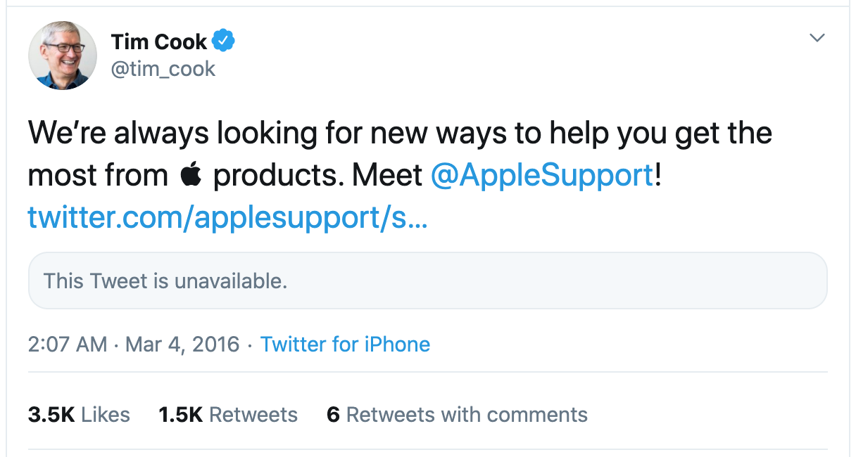
Research Question
The main research question for this project is:
What is the sentiment of tweets related to the upcoming iPhone 15, and what are the current most frequently used concerning and positive words associated with the product?

Slide 5
METHODOLOGY

Slide 6
Data crawling is a method which involves data mining from different web sources. Data crawling is very similar to what the major search engines do. In simple terms, data crawling is a method for finding web links and obtaining information from them.
DATA CRAWLING

Slide 7
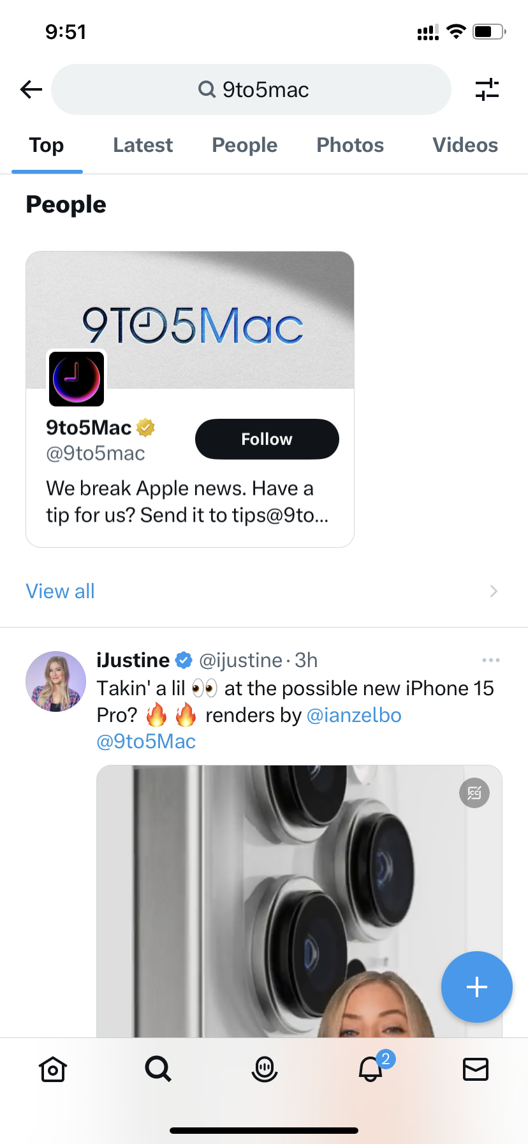
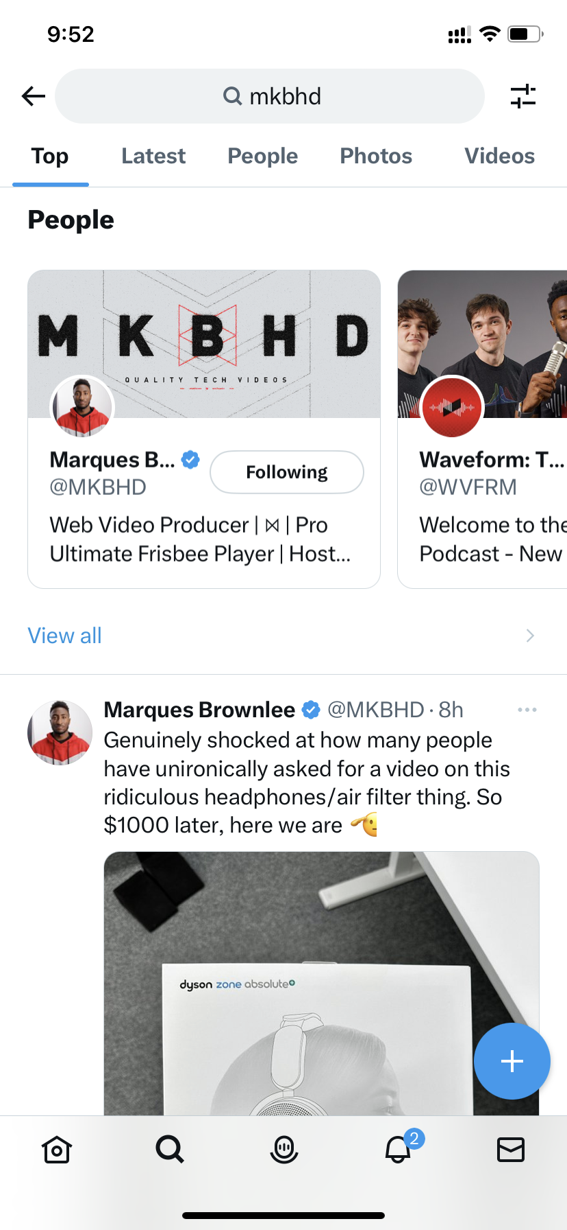
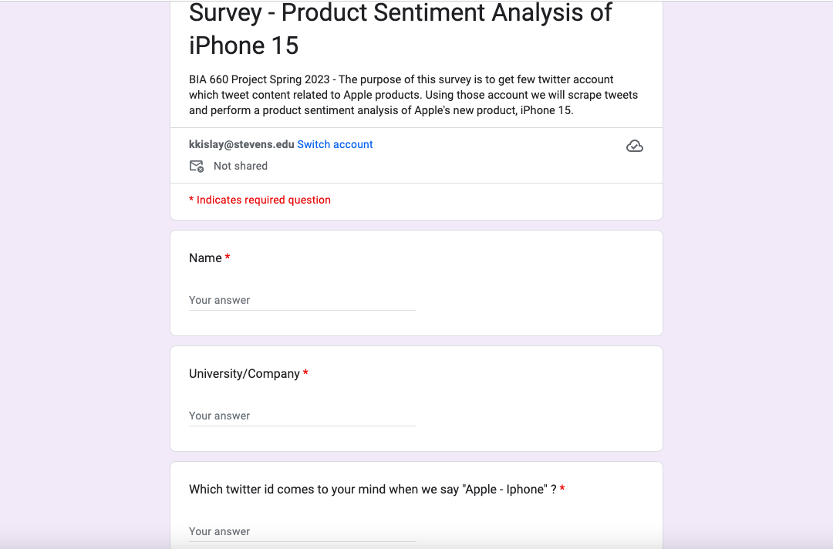
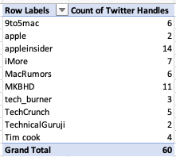
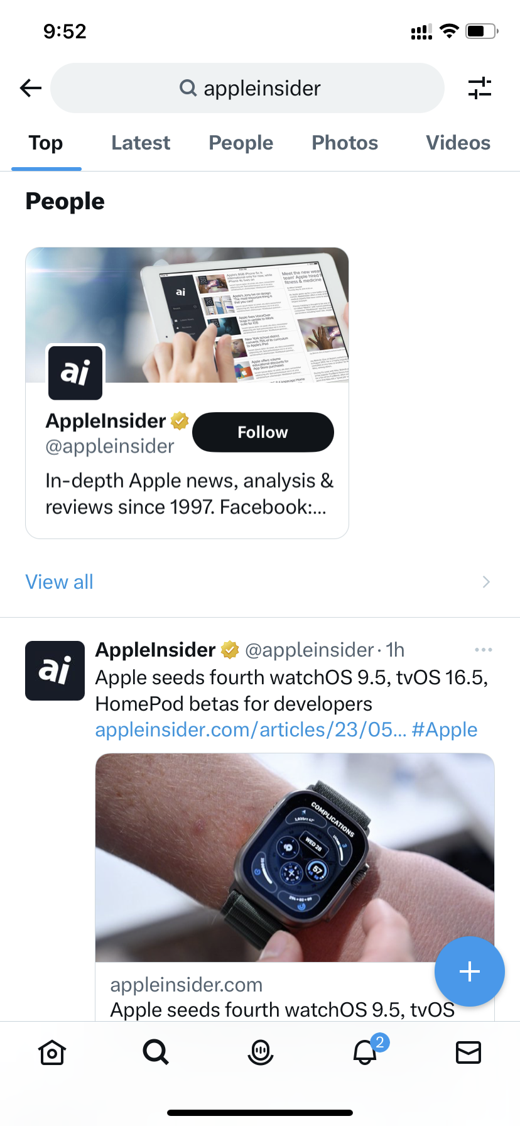
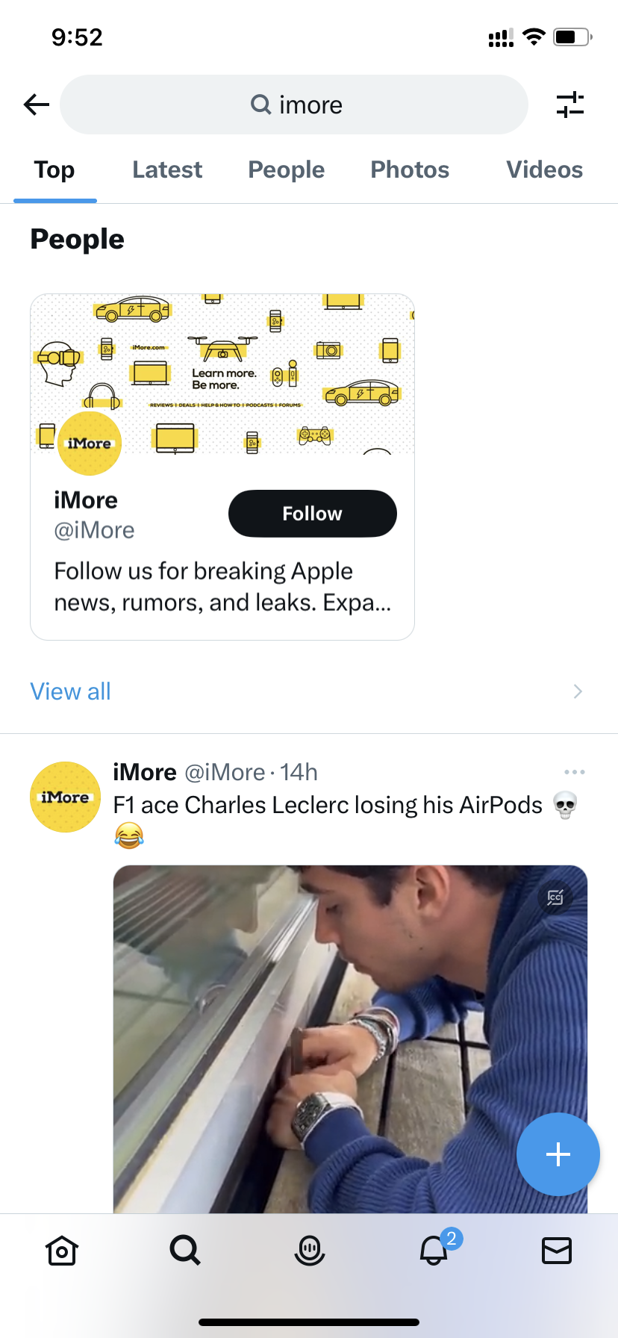
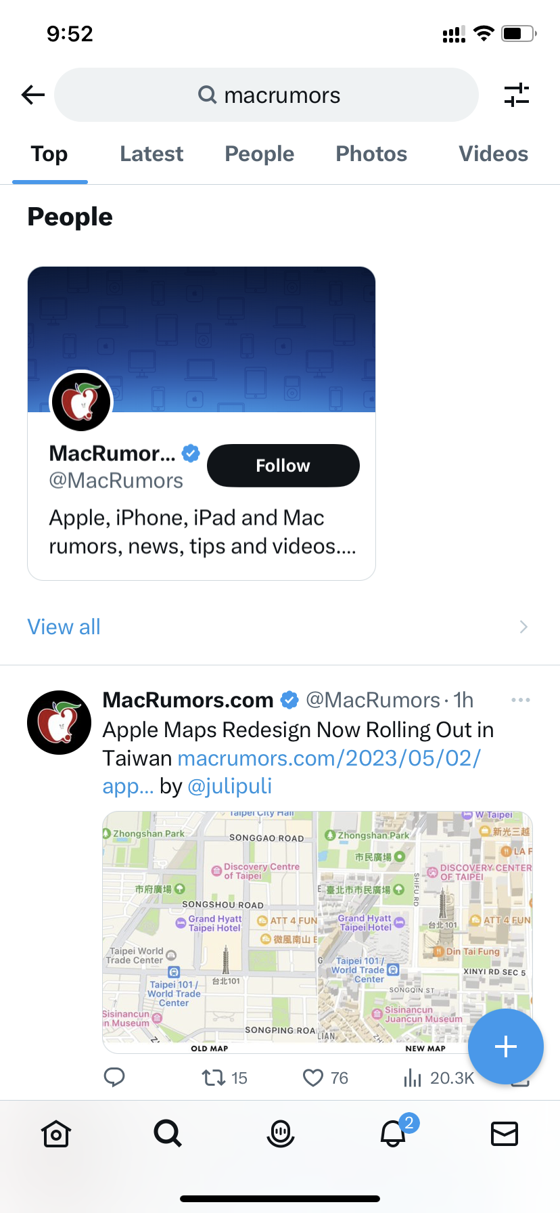
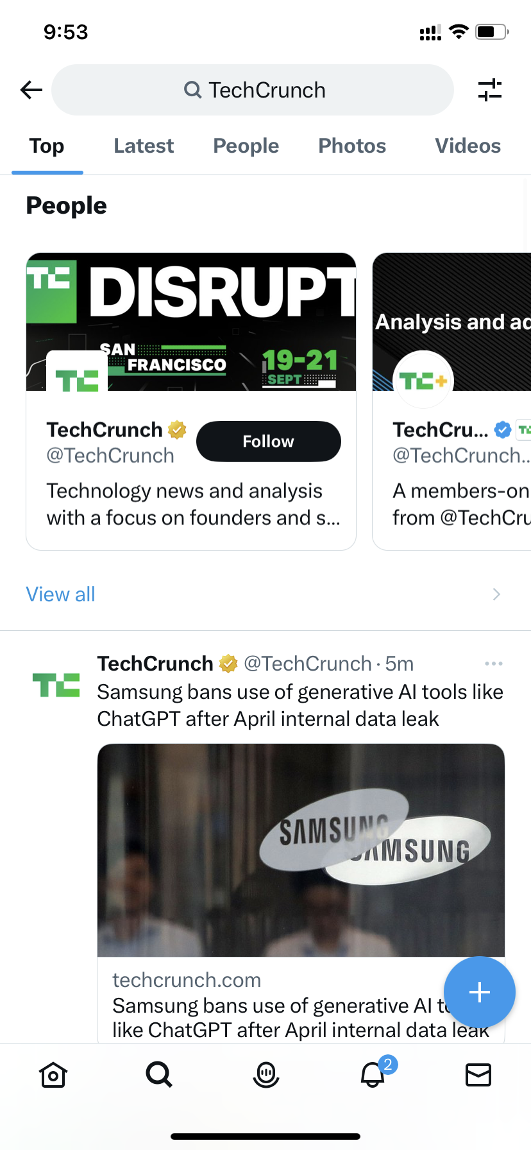
Data Crawling
Survey Link
Notes:
The data for this project was collected using the Twitter API, which allows developers to access and collect data from the Twitter platform.
In our survey we asked our friends/family to fill out any 3 tweeter account which comes to there mind when they think of iphone.
We collected around 20 responses and which included 10 different tweeter ids.
We then selected top 6 profiles from the survey response we did, that frequently tweet about iPhone-related topics, in order to gather a dataset that is focused on this specific product.

Slide 8

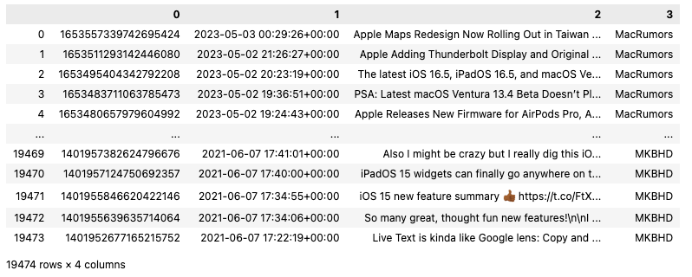
Data extracted
Notes:
The data collection process involved using Python's Tweepy library to access the Twitter API and retrieve tweets. We used Tweepy's user timeline method to retrieves the most recent tweets posted by a specific user.
Once the tweets were collected, we performed some data cleaning and preprocessing to ensure that the data was of good quality and ready for analysis. This involved removing any duplicate tweets, removing any tweets that did not contain any text, and removing any tweets that contained irrelevant information, such as advertisements or spam. We also removed any URLs, mentions, and hashtags from the tweet text, in order to focus on the content of the tweets themselves. Finally, we performed basic text cleaning, such as removing punctuation and converting all text to lowercase.
Overall, the data collection process was designed to ensure that we collected a high-quality dataset that was relevant to our research question and suitable for analysis.

Slide 9
Description of Crawled Data
4
19,474
Observations
Attributes in each observation
Notes:
The provided dataset contains 20000 observations and 4 attributes in each observation. Each observation represents a tweet posted by a user on a specific date and time. The variables in the dataset are:
1. ID: The unique identification number for each tweet.
2. Date and Time: The date and time at which the tweet was posted in the format of YYYY-MM-DD HH:MM:SS +00:00.
3. Tweets: The actual text of the tweet posted by the user.
4. User: The name of the user who posted the tweet.
Overall, the dataset provides a glimpse of tweets from various tech-related sources discussing different topics.

Slide 10

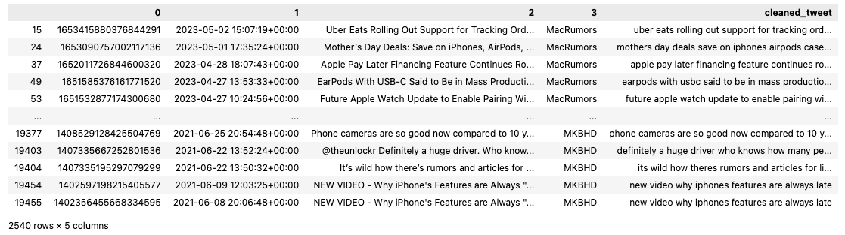
DATA CLEANING

Slide 11
Topic modeling is an unsupervised machine learning technique that's capable of scanning a set of documents, detecting word and phrase patterns within them, and automatically clustering word groups and similar expressions that best characterize a set of documents.
ANALYTICAL STRATEGY
TOPIC MODELLING

Slide 12
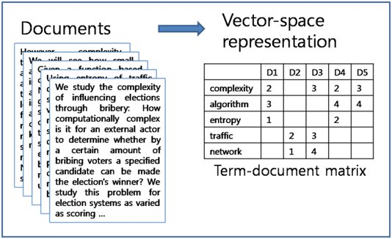

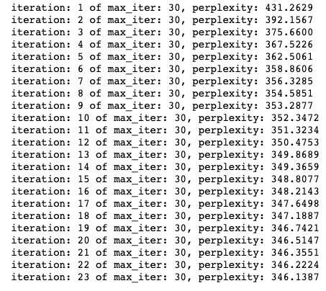
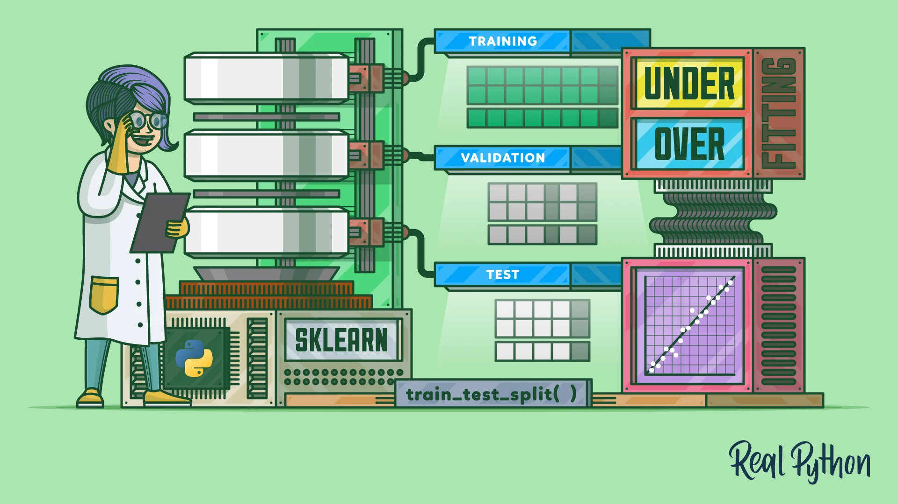
Creation of Term Frequency Matrix and Train LDA Model
Feature Names
OUTPUT
TRAINING
Notes:
Term Frequency Matrix
This code reads a CSV file with preprocessed tweets and creates a term frequency matrix using CountVectorizer from scikit-learn. It removes stop words from the English language and trains the vectorizer on the cleaned_tweet column of the dataset.
Then, it obtains the feature names using get_feature_names() function and prints the first ten of them along with the shape of the matrix.
Finally, it splits the dataset into a training set (90%) and a test set (10%) using train_test_split() function. The test set will be used to evaluate the perplexity of the topic modeling.
The above code trains a Latent Dirichlet Allocation (LDA) model on the term frequency matrix generated from the preprocessed tweets. The LDA model is a generative probabilistic model that allows the identification of hidden topics within a corpus of text. The model takes the term frequency matrix as input and learns the distribution of topics in the corpus and the distribution of words within each topic.
The num_topics parameter specifies the number of topics that the model should identify in the corpus. In this case, the model is set to identify four topics.
The max_iter parameter controls the maximum number of iterations that the model should perform during training. The verbose parameter controls the amount of output that is printed during training. The evaluate_every parameter specifies how often the perplexity of the model should be calculated. The n_jobs parameter specifies the number of parallel threads that should be used during training.
The LatentDirichletAllocation function from the sklearn.decomposition module is used to create the LDA model. The fit function is then called on the term frequency matrix (X_train) to train the model.
The output shows the perplexity scores for each iteration of the LDA model's training process. Perplexity is a metric that indicates how well the model fits the data, with lower values indicating a better fit. In this case, the perplexity starts at 436.8957 and gradually decreases over the 30 iterations, with the final perplexity score of 347.4540. This suggests that the LDA model is learning to better represent the topics present in the text data.

Slide 13
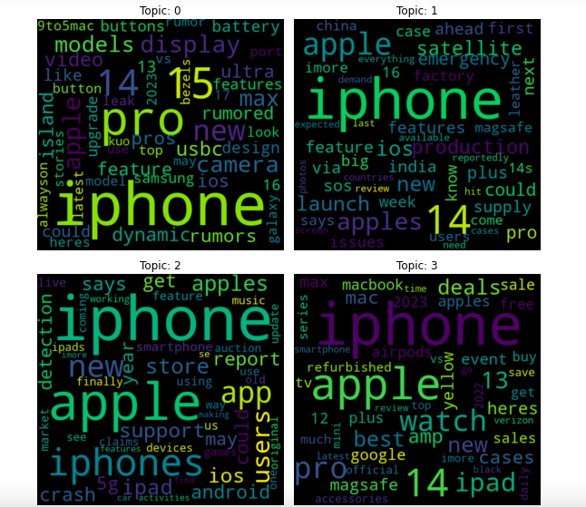
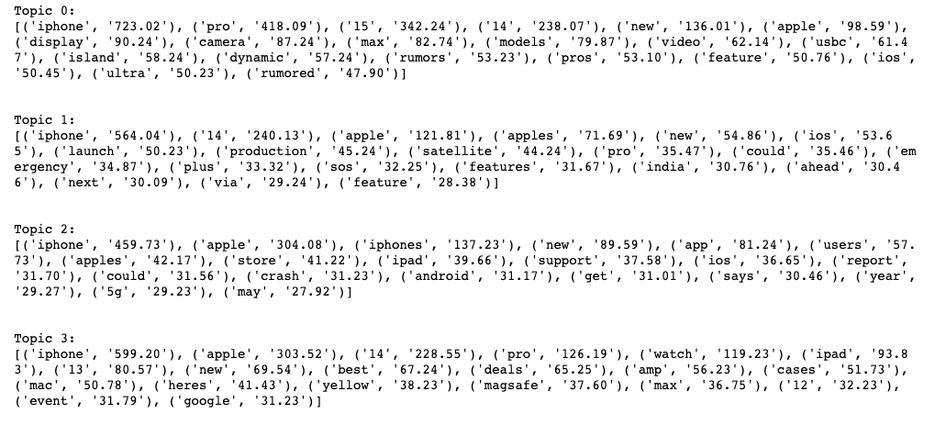
Topic 0 seems to focus on upcoming features and updates for iPhones, as well as battery life and support for Android.
Topic 1 also relates to iPhones and Apple, but with a focus on production and suppliers, as well as rumors and potential updates.
Topic 2 covers a range of Apple products, including the iPhone, iPad, and Apple Watch, as well as deals and cases.
Topic 3 appears to be more specific, focusing on rumored features for the iPhone 15, including dynamic wallpapers and satellite support.
The topics identified by the LDA model are related to Apple products, particularly iPhones, and their features and updates.
Notes:
This code block prints out the top 20 words for each topic learned by the Latent Dirichlet Allocation (LDA) model that was trained in Exercise 3.3.
The lda.components_ attribute returns a KxN matrix where K is the number of topics and N is the vocabulary size. Each row represents the distribution of words for a particular topic. The argsort() function sorts the topic distribution in descending order, and [::-1] reverses the order so that the most probable words are first. The [0:num_top_words] selects the top num_top_words words.
The output shows the top 20 words for each topic and the probability score (pseudo-counts) associated with each word in the topic.
It seems that the topics identified by the LDA model are related to Apple products, particularly iPhones, and their features and updates.
Topic 0 seems to focus on upcoming features and updates for iPhones, as well as battery life and support for Android.
Topic 1 also relates to iPhones and Apple, but with a focus on production and suppliers, as well as rumors and potential updates.
Topic 2 covers a range of Apple products, including the iPhone, iPad, and Apple Watch, as well as deals and cases.
Topic 3 appears to be more specific, focusing on rumored features for the iPhone 15, including dynamic wallpapers and satellite support.
Each topic also seems to have a clear set of top words that are most closely associated with it. For example, Topic 2 is closely linked with words like "cases", "camera", and "deals", while Topic 3 has more unique words like "island" and "emergency".
The code above visualizes the topics generated by the LDA model as word clouds. The code generates a 2x2 grid of subplots, with each subplot representing a topic. The words in each topic are represented as a word cloud, with the size of the words representing their frequency in the topic. The resulting visualization allows us to quickly understand the main topics in the corpus and the most important words associated with each topic.
The output shows the perplexity score for each number of topics ranging from 2 to 9. Lower perplexity scores indicate better topic models. Therefore, based on the given output, the best number of topics can be subjective and dependent on the use case. However, a common approach is to choose the number of topics that leads to the lowest perplexity score. In this case, the model with 2 topics has the lowest perplexity score, which means it might be the best choice for this specific corpus.

Slide 14
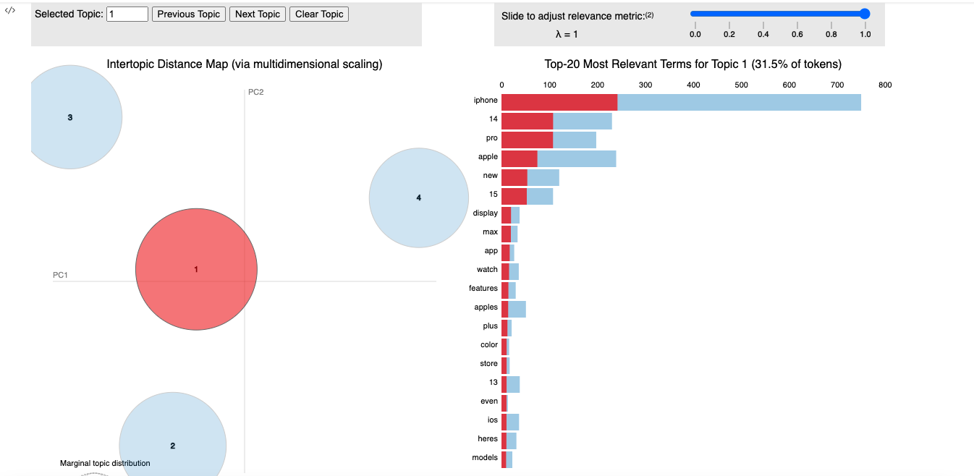
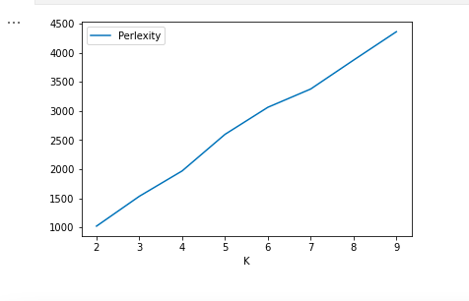

Slide 15
A semantic network is a knowledge structure that depicts how concepts are related to one another and illustrates how they interconnect. Semantic networks use artificial intelligence (AI) programming to mine data, connect concepts and call attention to relationships.
ANALYTICAL STRATEGY
SEMANTIC NETWORKS

Slide 16
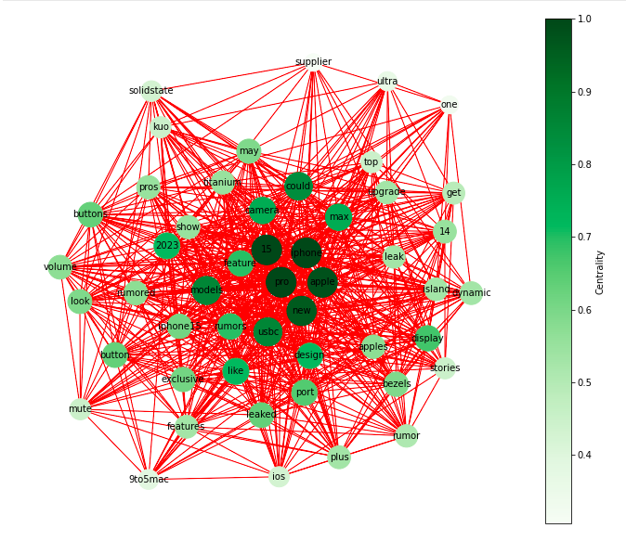
Removed stop words from the text data
Transformed into matrix of word frequencies
Frequency matrix converted to Binary matrix(0s and 1s)
Dimensionality reduction of binary matrix (using SVD),preserving as much information as possible.
Using this reduced matrix to calculate pairwise distances between the words using the cosine distance metric.
Finally, the function calculates the eigenvector centrality of each node in the graph.
The function returns the graph object, node sizes, and centrality measures for further analysis and visualization.
Notes:
The function 'build_semantic_network' aims to analyze the semantic network of text data using graph theory. The function takes a pandas DataFrame as input, and the data in the DataFrame must contain a column called "cleaned_tweet," which contains preprocessed text data. The output of the function is a graph object representing the semantic network, along with the node sizes and centrality measures of the nodes.
The first step of the function is to remove stop words from the text data using the NLTK library. The function then uses the CountVectorizer function from the scikit-learn library to transform the text data into a matrix of word frequencies. The CountVectorizer function also sets a minimum frequency threshold for the words and a maximum number of features to keep, which are set to 2 and 50, respectively, in this function.
Next, the function creates a binary matrix by applying a Binarizer function to the frequency matrix. The Binarizer function converts the frequency matrix into a binary matrix where each entry is either 0 or 1, indicating whether a word co-occurs with another word in the same document.
The function then uses the TruncatedSVD function from scikit-learn to reduce the dimensionality of the binary matrix while preserving as much information as possible. The reduced matrix is then used to calculate pairwise distances between the words using the cosine distance metric.
The function then creates a graph object using the NetworkX library, with each word in the text data represented as a node in the graph. The function adds edges between nodes if the corresponding words co-occur in the same document. The weight of each edge is the frequency with which the two words co-occur.
Finally, the function calculates the eigenvector centrality of each node in the graph, which is a measure of the node's importance in the network. The function uses the centrality measures to set the size of each node in the graph, with more central nodes having larger sizes. The function returns the graph object, node sizes, and centrality measures for further analysis and visualization.
In summary, the 'build_semantic_network' function is a useful tool for analyzing the semantic network of text data. It applies various techniques such as dimensionality reduction, graph theory, and centrality measures to extract meaningful insights from the text data. The resulting graph can be visualized and further analyzed to understand the relationships between different words and concepts in the text data.
—---------------------------------------
So, first we removed stop words from the text data. Then transformed the text data into a matrix of word frequencies.
Then the frequency matrix into a binary matrix where each entry is either 0 or 1, indicating whether a word co-occurs with another word in the same document.
Then we reduce the dimensionality of the binary matrix (using SVD) while preserving as much information as possible. The reduced matrix is then used to calculate pairwise distances between the words using the cosine distance metric.
Finally, the function calculates the eigenvector centrality of each node in the graph, which is a measure of the node's importance in the network. The function returns the graph object, node sizes, and centrality measures for further analysis and visualization.

Slide 17
Sentiment analysis is the process of analyzing digital text to determine if the emotional tone of the message is positive, negative, or neutral. Today, companies have large volumes of text data like emails, customer support chat transcripts, social media comments, and reviews.
ANALYTICAL STRATEGY
SENTIMENT ANALYSIS

Slide 18

The objective here is to perform sentiment analysis on a dataset of tweets using the VADER (Valence Aware Dictionary and sentiment Reasoner) sentiment analysis tool.
The resulting sentiment scores are then used to create new columns in the dataset for each sentiment type (negative, neutral, positive) and a compound score that represents an overall sentiment score.

Slide 19
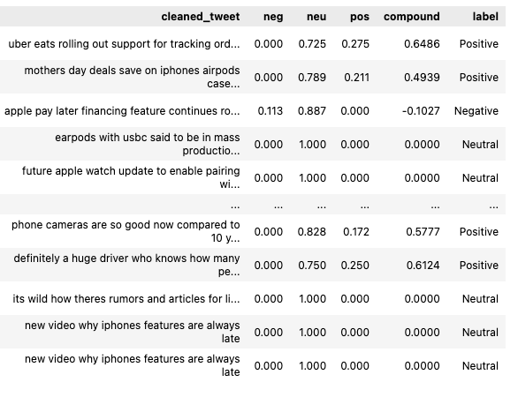
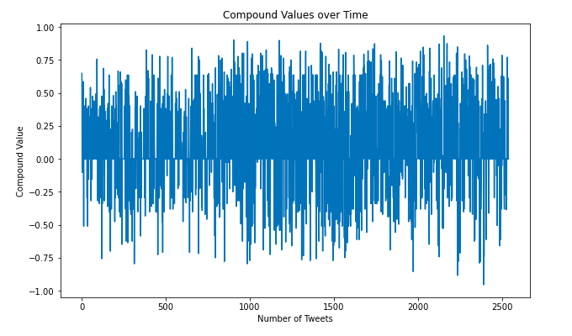

Slide 20
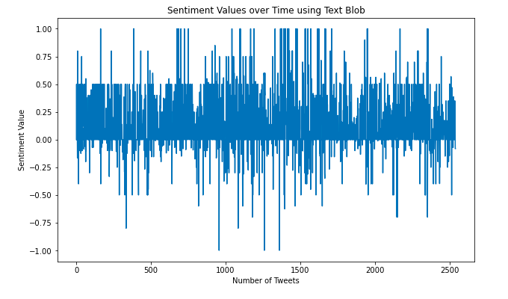
Sentiment Analysis using Text BLob

Slide 21
Result
The VADER sentiment analysis tool provides a simple and effective way to perform sentiment analysis on a dataset of tweets. The overall mean sentiment score is 0.0931.
The output for text modelling includes the top words per topic, word cloud visualization, topic mixture for documents, perplexity values, and topic visualization. Based on the results, the best number of topics is found to be 2, since the perplexity score was 2107 which was lowest for 2 .
From the centrality dictionary, we can see the centrality measure for each node in the network. We can see that the nodes with the highest centrality measure are ”iphone", "15", "apple", and "new". This indicates that these words are the most central and connected in the semantic network.. Overall, we can conclude that the semantic network provides insights into the key topics and themes discussed in the tweets.

Slide 22

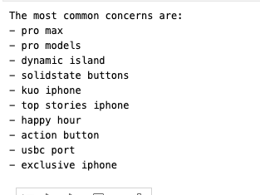
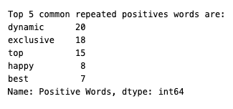
Conclusion
iPhone 15

